Slide 1

House Price Prediction
By: Anil Kumar (21/BCADS03)

Slide 2

Introduction
In this project we have built a machine learning model to predict the house prices of Indian City (Bangalore).
This project will be very helpful for the real estate market.
Our model can be used by both seller and buyers.

Slide 3

Goals and Objectives
The objective of house price prediction is to develop a reliable and accurate model using advanced analytical techniques and machine learning algorithms. The primary goal is to predict house prices based on various factors such as property location, size, number of bedrooms, property characteristics and market trends.

Slide 4

Problem Statement
Prices of real estate properties are sophisticatedly linked with our economy.
Despite this we do not have accurate measures of house prices based on the vast amount of data available.
Proper and justified prices of properties can bring in a lot of transparency and trust back to real estate industry which is very important for most consumers, especially in India.

Slide 5
Pipeline
Data Cleaning
Feature Engineering
Outlier Removal
Outlier Detection
One Hot Encoding
Model Creation

Slide 6

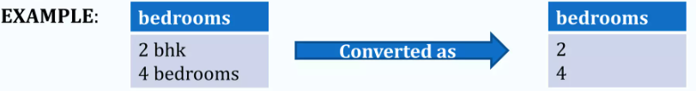
Data Cleaning
The main aim of Data Cleaning is to identify and remove errors & duplicate data, to create a reliable dataset.
The process of data cleaning is done by using a very famous library pandas.
Initially, those columns/features are dropped from our dataset who are not important in deciding the final price.
The rows having a null value in any columns are dropped from our dataset.
The columns having characters as well as integer values are converted into integer values only.
Many more data cleaning techniques are used to improve the quality of our dataset.

Slide 7

Feature Engineering
Feature engineering is the process of using domain knowledge to extract features from raw data via data mining techniques. These features can be used to improve the performance of machine learning algorithms. Feature engineering can be considered as applied machine learning itself.
Dimensionality reduction techniques are used in our dataset to reduce those rows who are not very much important to decide the house price.
Example: Converting total no. of bathrooms and bedrooms into a single feature called total rooms.

Slide 8

Outlier Detection
In simple words, an outlier is an observation that diverges from an overall pattern on a sample.
There are many types of outlier detection techniques such as Z-Score or Extreme Value Analysis, Probabilistic and Statistical Modelling, Information Theory Models, Standard Deviation etc.
We have used simple domain knowledge of real estate market to detect the outliers in our dataset.

Slide 9

Outlier Removal
After detecting the outlier, correct that errors if possible and if you cannot fix it, then remove that observation.
In our dataset, we observed variations in the relation between values of some attributes.
So that these type of rows are dropped from the dataset.
Scatter plots are used to detect some more outliers and they are also removed from our dataset.

Slide 10
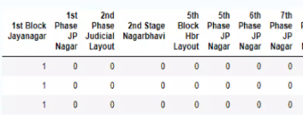
One Hot Encoding
This technique is used to convert the categorical variables into numeric values.
Our dataset contains a categorical variable which is "location".
We have used one hot encoding method to convert them as numeric values.
As we can see the location name 1st Block Jayanagar having the value 1 and the rest of locations are treated as 0.

Slide 11
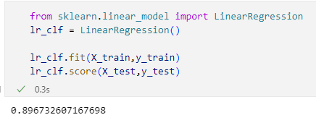
Model Creation
The process of modelling means training a machine learning algorithm to predict the labels from the features.
We have used Linear Regression algorithm for training and testing of the model.
The accuracy rate of our model is 89% which is pretty good.

Slide 12
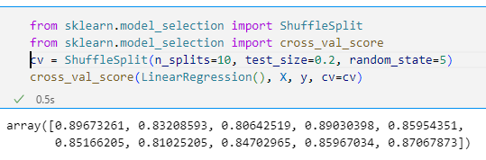
K-Fold Cross Validation
Cross-validation is a statistical method used to estimate the skill of machine learning models.
It is commonly used in applied machine learning to compare and select a model for a given predictive modelling problem because it is easy to understand, easy to implement, and results in skill estimates that generally have a lower bias than other methods.
After applying k-fold cross validation method into our final dataset, we find our accuracy rate is more than 84% all the time.

Slide 13
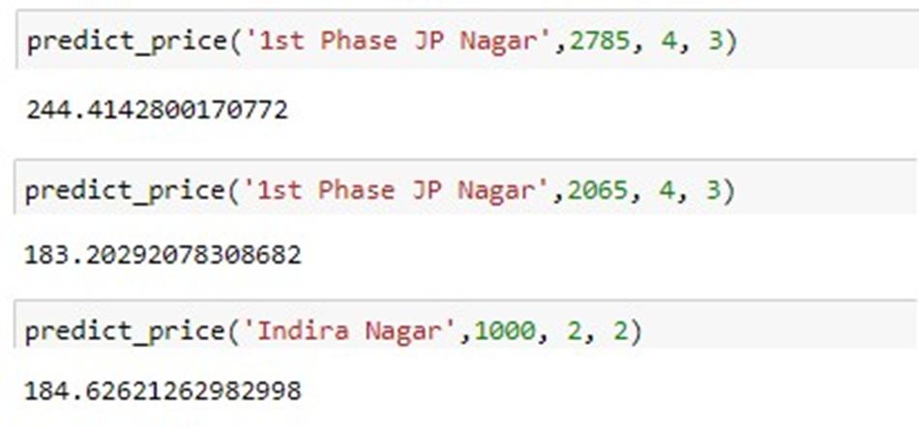
Result/Output
We created a function to predict the house price.
Our function be like “predict_price(location, total_sqft, bath, bhk)”.
When we pass the values into our function it will predict house price for us.

Slide 14

Hardware Requirements
Computer Desktop or Laptop
System will be using
Processor : Core2Duo
Main Memory : 4GB RAM
Hard Disk : 320GB
Display : 14" Monitor

Slide 15
Software Requirements
Python language
OS : Window 10 64-bit or Higher
Language : Python, HTML
Tool Used : Nginx, VS code, Chrome

Slide 16

Thank You

